Slide 1
UNIFORM COLOR SPACES, COLOR DIFFERENCE SPECIFICATION AND COLOR APPEARANCE PHENOMENA

Slide 2
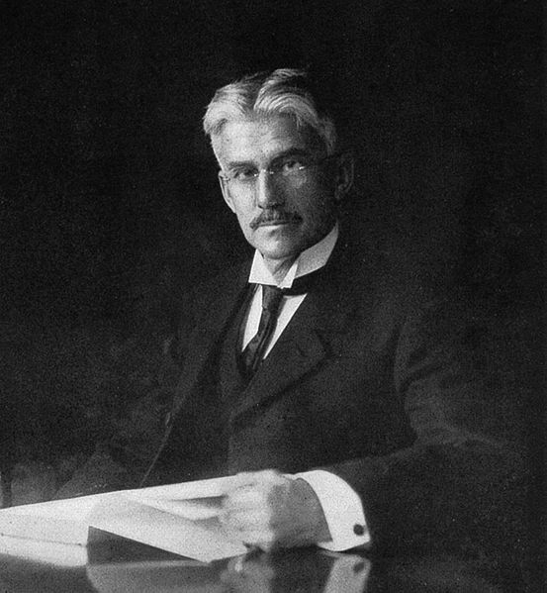


Color Order Systems
Munsell Color Order System
Based on perceptual attributes of color.
Hue
Chroma (Saturation)
Value (Lightness)
Munsell created his color atlas in conjunction with an artist who carefully painted samples to match Munsell's conception.
In 1929 the Optical Society of America commissioned a study to instantiate the Munsell colors into XYZ.
Image from Wikipedia
Albert H. Munsell

Slide 3
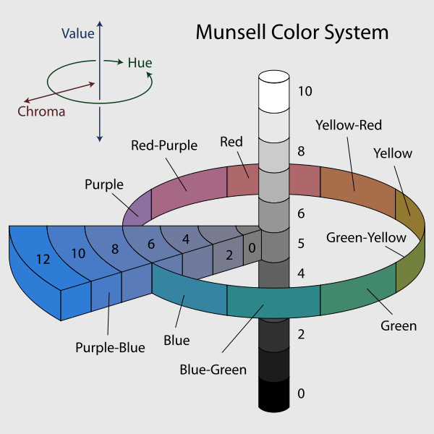
Munsell Color Order System
Image from Wikipedia

Slide 4
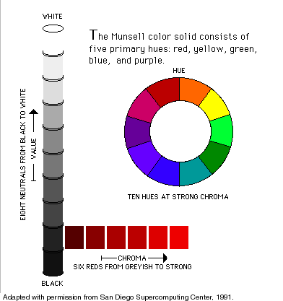
Munsell Hue
Circular scale based on 10 major hues
Red ( R)
Yellow-Red (YR)
Yellow (Y)
Green-Yellow(GY)
Green (G)
Blue-Green(BG)
Blue (B)
Purple-Blue (PB)
Purple(P)
Red-Purple (RP)

Slide 5
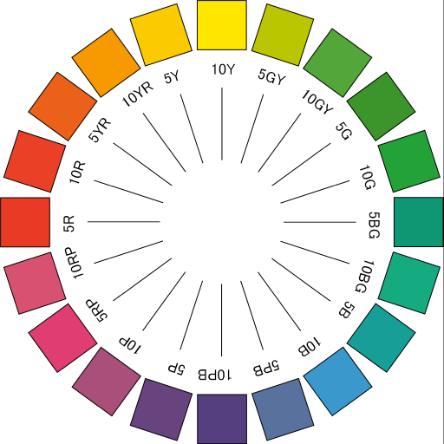
Munsell Hue
The Hue Scale is further subdivided into a scale range of 1 to 10 with 5 the major hue itself.
A digit-letter notation is used to specify Munsell hue.
Example: 2.5R means the 2.5 step R in major hue category Red.
Image from http://igl.net.au

Slide 6
Munsell Chroma
Starts from 0 to possible maximum chroma of each hue.
O chroma indicates white, gray or black.
The higher the chroma value, the purer the color.
Equal steps on the chroma scale represent equal changes in perceived chroma.
Image from Wikipedia

Slide 7
Value (Lightness)
Numerical scale of lightness from 0 (black) to 10 (white)
Samples that differ in Munsell hue or chroma that have the same VALUE should be judged to represent equal changes in perceived lightness.
Image from Wikipedia

Slide 8
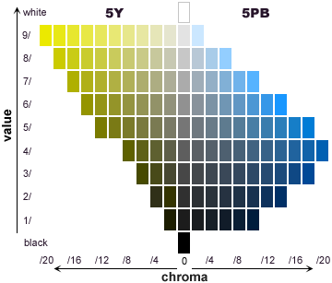

Munsell Notation
Hue Value/Chroma
2.5R 8/4 means
2.5 Red
Value 8
Chroma 4
Letter N denotes neutral samples and chroma value is omitted
N 8/
Neutral sample value 8 chroma 0.

Slide 9
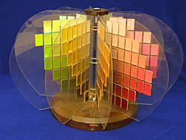
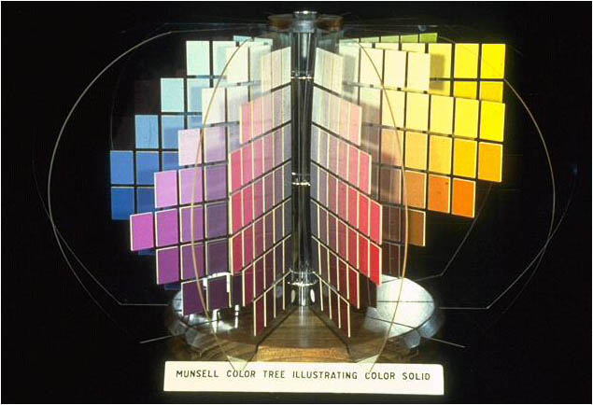
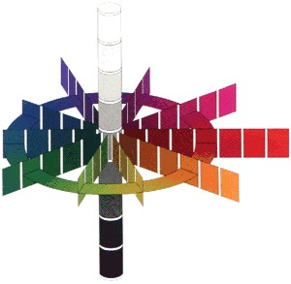
Munsell Color Tree
jiscdigitalmedia.ac.uk
jaimetreadwell.com
urbanext.illinois.edu

Slide 10
Uniform Color Spaces

Slide 11
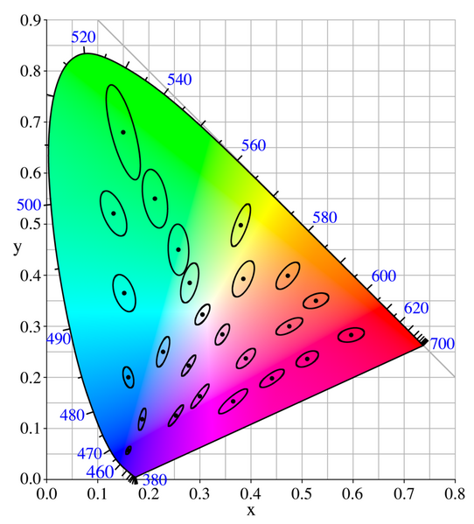
McAdam Ellipses
1943 and 1957 Experiment by McAdam
Subjects were asked to match 25 chromaticities using 3 lights
Repetitions reveal spread of color match per observer.
Image shows 10sd (stdev) size of original ellipse from one observer

Slide 12
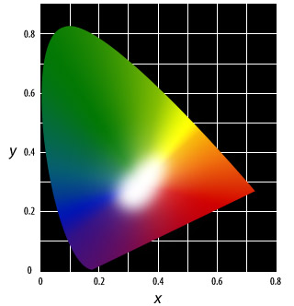
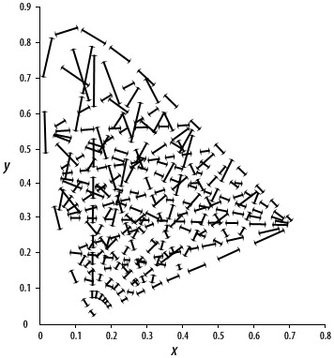
Perceptual Uniformity
Image from http://dba.med.sc.edu/price/irf/Adobe_tg/models/cieluv.html

Slide 13
CIE saw the need for a perceptually uniform color space
If two colors are perceptually different in this space, the unit of perceptual distance should be the same for any other pair of colors.
CIE adopted two proposals in 1976 (no consensus as to which was better)
CIE L*u’v’
CIE L*a*b*

Slide 14
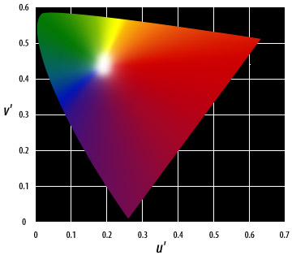
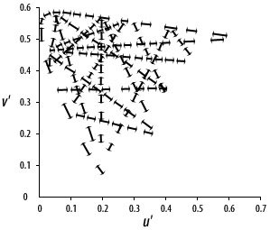
1976 CIE L* u’ v’
Stretch the CIE xy space such that the perceptual distances will become uniform.

Slide 15
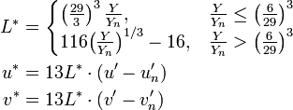

Transformation
L* is correlated to luminance
Yn : Luminance of a white object
un, vn : chromaticity coordinates of the white object

Slide 16
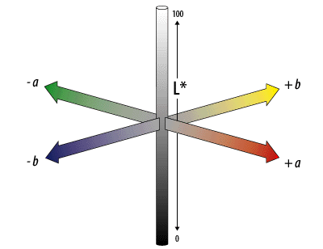
1976 CIE L* a* b*
Approximates human color vision
Uses an “opponent color” space
a: red (+) to green(-)
b: yellow (+) to blue (-)
L component closely matches Lightness perception
Inspired by Munsell color order system

Slide 17
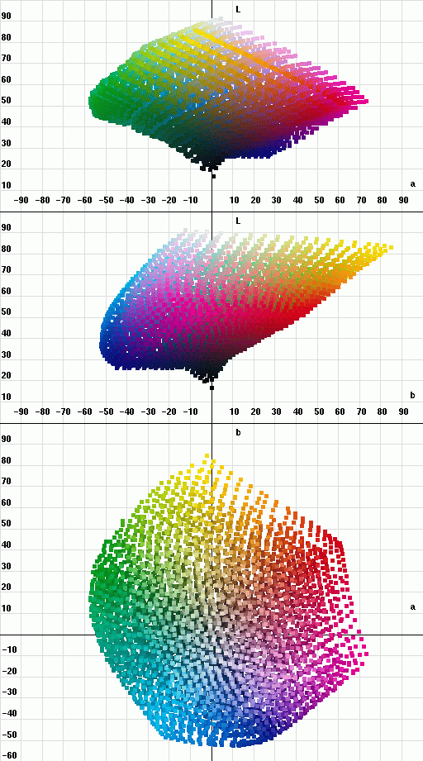
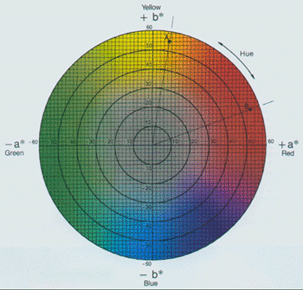
Some representations of CIE L*a*b*
Image from X-Rite inc/Analogue Digital Services Ltd.
Gamut of an EPSON Stylus Photo 750/1200, a 6-color ink-jet printer
http://www.arahne.si/colors.html

Slide 18


CIE L*a*b* Transformation
where
L : Lightness, ranges from 0 to 100
Xn, Yn, Zn : tristimulus values of the reference white point

Slide 19
Color Difference

Slide 20
Color Difference CIE76 ΔE
To determine the perceptual color difference between two colors
ΔE ≈ 2.3 corresponds to Just Noticeable Difference (JND)
ΔE = 4.0 color difference tolerance in digital cinema

Slide 21
Chroma and Hue
Define perceptual quantities
Chroma
Hue

Slide 22
Advances in Color Difference
CIE94 – provided corrections for nonlinearities in CIE Lab space. Uses L C and h space.
CIEDE2000 – TOO Complicated. Approved by CIE but not widely used beyond textile industry

Slide 23
For verification: From Color Science (Shevell), formula for b* is different

Slide 24
Limitations of Color Difference
Applicable only to single patch matching
CIELab or CIELuv does not completely make the McAdam ellipses circular
Neglects color appearance phenomena

Slide 25
Color Appearance Phenomena

Slide 26
Color Appearance Phenomena
The appearance of color is affected by several factors:
Surrounding colors
Ambient light
Patterns
Spatial arrangement of colors
Memory

Slide 27
Induced CIELab does not include the context of the color. Both x’s have the same color yet appear different. This is INDUCED HUE

Slide 28
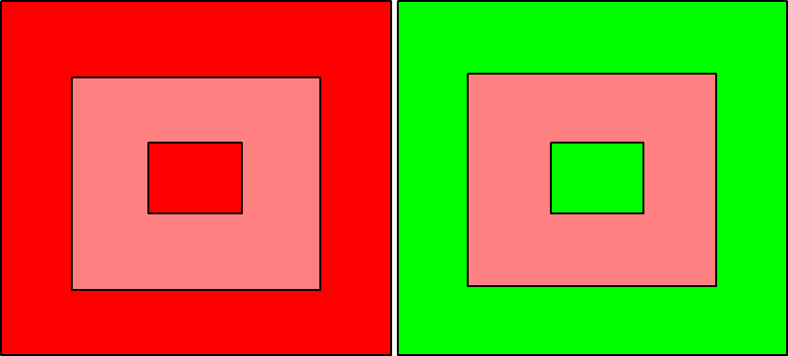
Induced Saturation

Slide 29

Induced Brightness

Slide 30
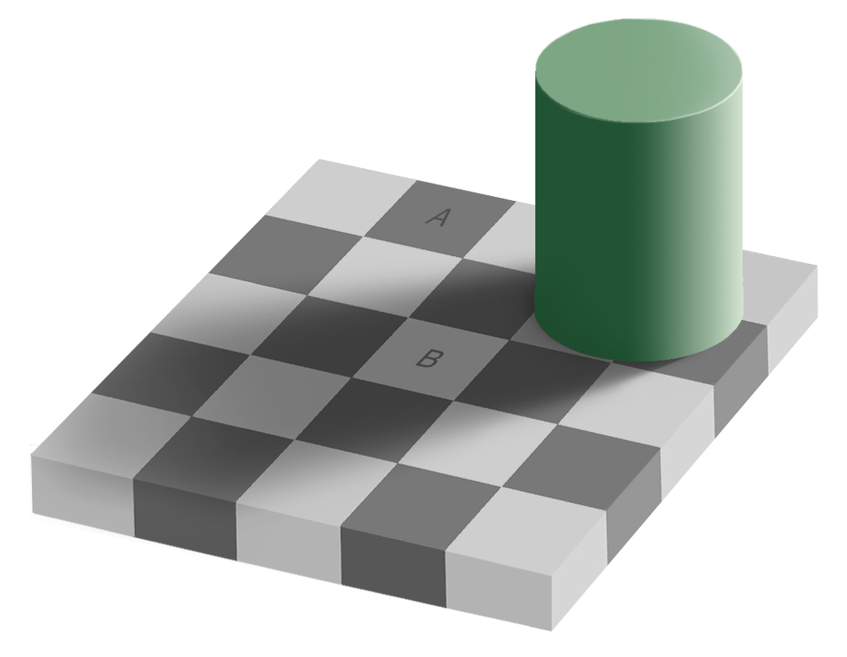
Another example

Slide 31


Slide 34
Current Directions in Color Specification
sRGB
Developed by Microsoft and Fairchild
Spectrum as more complete description of color of object
Hyperspectral Imaging
Not tristimulus-based
Suitable since high capacity storage devices and more powerful processors are now available.

